Slide 1


A chatbot for Intent Based Jira Search
Presented by
Hanish
Manasa
Soumya
Supriya

Slide 2
Team Introduction
Soumya
Supriya
Btech –CSE,CBIT
Btech –CSE,GRIET
Manasa
Btech –CSE,VNR
Hanish
Btech –CSE,Vasavi

Slide 3
Problem Statement
Jira search works based on keywords but it never understands user intention , if he wants related results he has to change the input.

Slide 4
Introduction\Proposed solution
In the proposed system, the Rasa NLU tries to understand user input and responds. It is done by interpreting the user intention and extracting entities which are used to generate the response.
NLP, or Natural Language Processing is a blanket term used to describe a machine’s ability to ingest what is said to it, break it down, comprehend its meaning, determine appropriate action, and respond back in a language the user will understand.
Tologies Used

Slide 5
Technologies Used
Machine learning .
Rasa is an open source framework to build contextual AI assistance.
Python 3.6
Flask to render HTML pages.

Slide 6
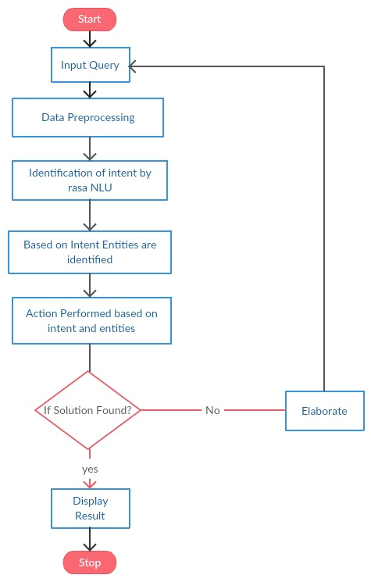
Flow chart

Slide 7
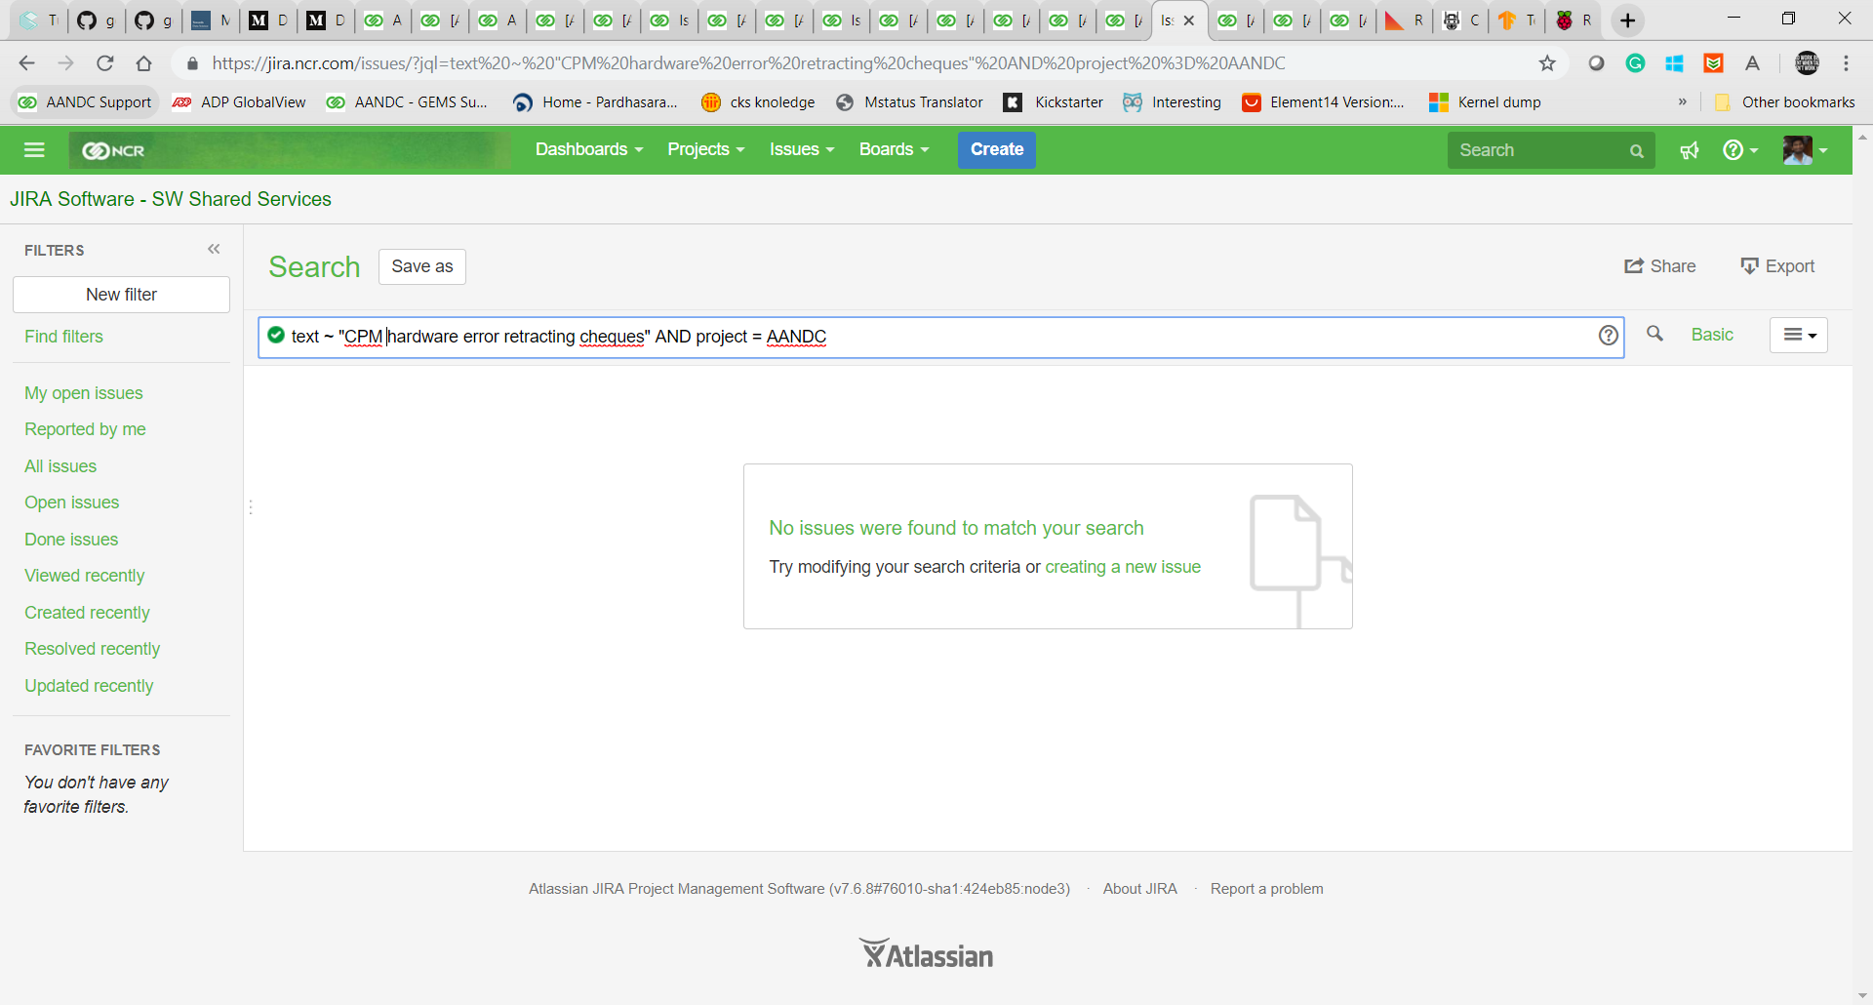
Demo / Prototype
Very important

Slide 8
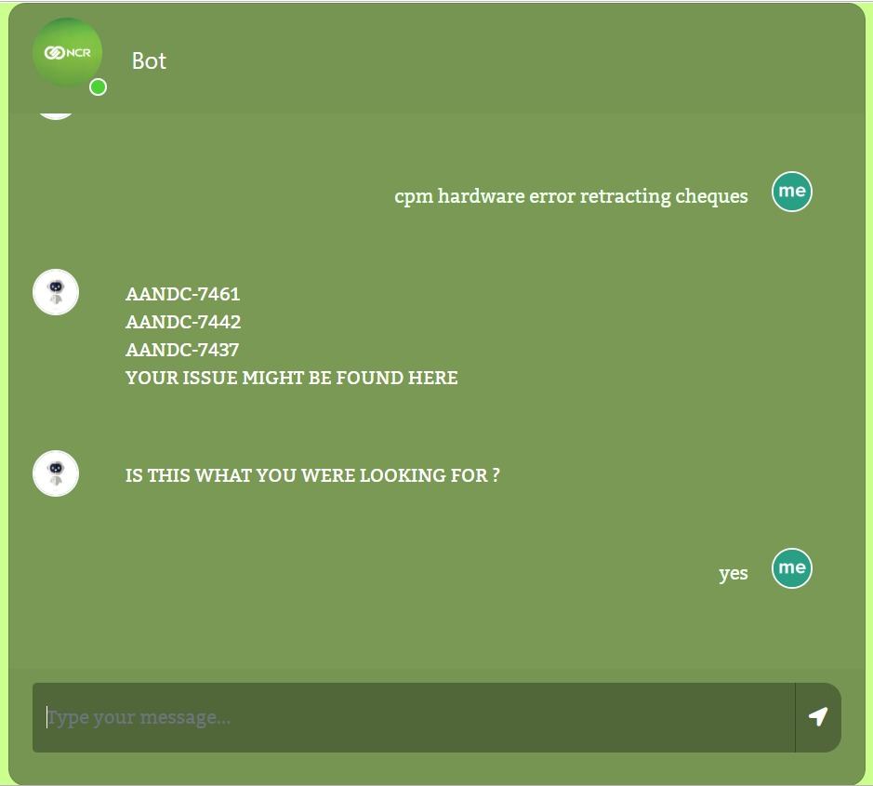

Slide 9
Benefits
It understands the user intent even if it is not properly ordered
Recognizes synonyms of the user input which are specific to NCR product
Better search results
Can be benefitted by Engg ,PS and Software support teams.

Slide 10


Hearty thanks to Pardhu

Slide 11
THANK YOU

